Slide 1
Advanced Developing with Eclipse Rich Client Platform (RCP)
DATE
CITY, COMPANY Trainer: TRAINER

Slide 2
Agenda
Introduction
Plug-in philosophy
Jobs
Adapters
JFace Wizards
Data Binding
Virtual Trees and Tables
Defining Extension Points
Customizing the Look and Feel
Help System
p2 - Provisioning and Update
Headless build
Wrap-up

Slide 3

About me: Ilya Shinkarenko
Software engineer / consultant
UI Frameworks: Eclipse RCP, Android, Flex
Eclipse RCP consulting, coaching and trainings
HCI, UX, Usability
Backends: OSGi, Spring, JBoss AS, etc.
Projects, consulting, workshops, seminars
Working in IT since 1997
Java since 2001
Eclipse RCP, OSGi since 2004
E-Mail: shinkarenko@suprematic.net

Slide 4
About me: Alexey Aristov
X
X
X
X
X
X
X
X
X
E-Mail: aristov@suprematic.net

Slide 5
About the Eclipse Training Alliance
Founded December 2005 by WeigleWilczek and Innoopract
SUPREMATIC SOLUTIONS now drives the initiative
Offerings:
International one-stop delivery of high quality Eclipse training classes
Certificates
Coaching and consulting
We share expertise

Slide 6




The Partners

Slide 7
Our Training Classes
Developing OSGi
Advanced OSGi
Developing RCP
Advanced RCP
Eclipse Modeling (EMF & GMF)
EMF Professional
Graphical Modeling with GMF
Model-Driven Development with Eclipse Modeling
MDD in the context of Software Engineering
Advanced MDD with Eclipse Modeling and openArchitectureWare
Administration Training
Architecture Training
Developer Training
Eclipse SOA Workshop
HYPERIC System Administration Training
Methodology Training

Slide 8

Contact Europe
Please contact us for details:
Eclipse Training Alliance
c/o CC3 GmbH
Jörn Weigle
Götzenbergstr. 34
D- 70329 Stuttgart
Phone +49 711 2203536
www.eclipse-training.net

Slide 9
About You
What is your motivation for this training class?
What are your goals?
What experiences do you have in ...
... Java?
... RCP / Plug-ins development?

Slide 10
Agenda
Introduction
Plug-in philosophy
Jobs
Adapters
JFace Wizards
Data Binding
Virtual Trees and Tables
Defining Extension Points
Customizing the Look and Feel
Help System
p2 - Provisioning and Update
Headless build
Wrap-up

Slide 11
The Case for Extensibility
Every complicated application has to be open for extension
Generally good practice
Better integration with other technologies
More business opportunities
Way to avoid “proprietary closed application” FUD

Slide 12
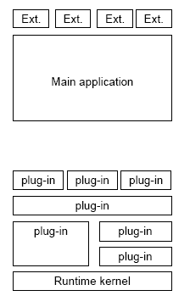
Extensible vs. Extension based Applications
Two approaches:
Extensible applications
i.e. Photoshop, MS Office, Mozilla
Full size application core with extension interface
Extension based platforms
i.e. Emacs, Auto CAD, Eclipse
Minimalistic runtime, that includes extension mechanism
High level language
Extension points mechanism

Slide 13
Extension Based Platforms
Application core acts as a container for extensions
All functionality is implemented inside extension modules
In case of Eclipse those are Plug-ins
Advantages
More open and transparent
Core functionality developers and those who extend applications share same programming approach
Easy to replace most functionalities

Slide 14
Implementing Extensions
Two ways for Eclipse based applications:
Extension registry
OSGi Services (whiteboard pattern)
First one is standard in case of Eclipse
What to choose depends on actual requirements
Metadata injection
Runnable code injection

Slide 15
Practical Hints / Advice
Do not hesitate to define own application specific extension points
Use your own extension points
Avoid “backdoors”
Put some effort into documenting extension points
This will help contributors a lot!
Take care of compatibility
Extension point definitions are contracts between you and those who extend. Respect them!

Slide 16
Modular Component Architecture
OSGi => modules for the Java platform
Highly dynamic and flexible
Loose coupling of Java modules
Modular Component Architecture, based on:
OSGi Bundles (= Eclipse Plug-ins)
Eclipse Features
For deployment options
For product lines
For different customer brandings
For different platforms

Slide 17
Bundle Granularity
Open questions:
What should be the size of a Bundle?
What functionality should be provided by a Bundle?
When to separate functionality into different Bundles?
How to organize Features?

Slide 18
What should be the size of a Bundle?
It depends…
If you don’t have much experience:
Start monolithic, then
Separate functionality into different Bundles
If it is a self-contained block
e.g. domain model, Help, Views, Editors
If it has the potential of reuse
e.g. Update, Views, Editors
If it should be updated separately
Separate core and UI functionality into different Bundles

Slide 19
How to organize Features?
These suggestions are not always the best solution, but might help to get started:
Plug-ins which are providing the basic functionality of your RCP application should be grouped in their own Feature
Plug-ins with additional / optional functionality should be grouped into separate Features
E.g. create a separate Help Feature (see bug 202160, resolved in Eclipse 3.4 ☺)
Create different Features for different product brandings
Create the .product configuration in the Feature project

Slide 20
Benefits of Eclipse’s Plug-in Philosophy
Through its Plug-in architecture RCP lets you:
Decompose your code into loosely coupled units
Extend (and update) your product incrementally
Enforce contracts between groups in your organization
Play nicely with components from other vendors
Allow even customers to extend your product

Slide 21
Agenda
Introduction
Plug-in philosophy
Jobs
Adapters
JFace Wizards
Data Binding
Virtual Trees and Tables
Defining Extension Points
Customizing the Look and Feel
Help System
p2 - Provisioning and Update
Headless build
Wrap-up

Slide 22
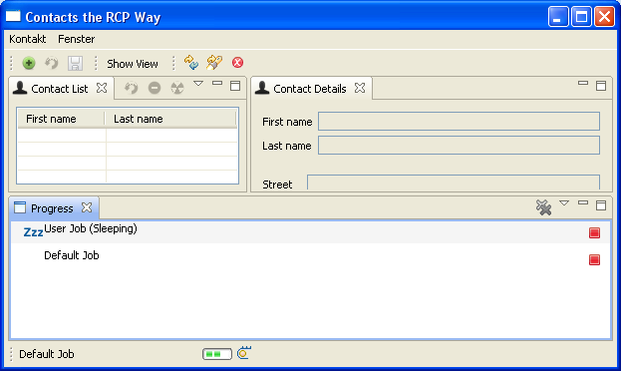
Jobs

Slide 23
Job infrastructure
The purpose of the Jobs API is to provide a means to execute long running tasks without blocking the UI
The advancement of those background jobs can be tracked in your RCP application:
In the progress View
In the progress indicator area
In order to define a job you need to provide a class that inherits from org.eclipse.core.runtime.jobs.Job
Behind the scenes a Job Manager executes and supervises all jobs

Slide 24
Job types
There are three different types of jobs which primarily differ in the way they report on progress:
Default jobs → reporting in progress view & indicator area
User jobs → additional reporting in a modal dialog
System jobs → no reporting in the UI

Slide 25
Job lifecycle
Each job goes through a well defined lifecycle
The lifecycle of a job can be traced by checking the job state
NONE (after job has been created / after job was finished)
SLEEPING (when programmer decides to put the job to sleep)
WAITING (after job was scheduled and is waking up after sleep)
RUNNING (when job is executing)

Slide 26
Job implementation
The most simple job looks like this:
public class MyDemoJob extends Job {
public MyDemoJob(final String name) {
super(name);
}
@Override
protected IStatus run(IProgressMonitor monitor) {
// code to be executed goes here
return Status.OK_STATUS;
}
}

Slide 27
Job progress
If you want to report on job progress you can use the progress monitor that is provided by the framework:
public MyProgressReportingJob(String name, int ticks) {
super(name);
this.ticks = ticks;
}
protected IStatus run(IProgressMonitor monitor) {
int progress = 0;
while(progress < ticks) {
// code to be executed goes here
monitor.setTaskName("Total: " + progress++);
monitor.worked(1);
}
monitor.done();
return Status.OK_STATUS;
}

Slide 28
Job execution
The execution of a default job can be triggered by:
If you want to create user or system jobs you can should call the job.setUser(boolean) and job.setSystem(boolean) API
Job job = new MyDemoJob(“My first Job");
job.schedule(2000);

Slide 29
Lab tasks
Activate the progress indicator area in the Workbench Window Advisor
Add the Progress View to the application by contributing to org.eclipse.ui.views
Hint: org.eclipse.ui.ExtensionFactory:progressView needs to be the value of class attribute in order to add the framework’s default Progress View
Create the different kinds of jobs (default, user, system) and check on their different behavior
Create a job that reports its progress by using the progress monitor facility

Slide 30
Agenda
Introduction
Plug-in philosophy
Jobs
Adapters
JFace Wizards
Data Binding
Virtual Trees and Tables
Defining Extension Points
Customizing the Look and Feel
Help System
p2 - Provisioning and Update
Headless build
Wrap-up

Slide 31

Adapters

Slide 32
What is an Adapter?
In object-oriented software systems, an adapter simply adapts (converts) an object of type A to another object of relevant type B
Eclipse provides the interface IAdaptable to address the adaption of an object:
Since model objects should not depend on Eclipse, Adapter-Factories can adapt all objects. Even if they do not implement IAdaptable…
How does this work?
public interface IAdaptable { public Object getAdapter(Class adapter); }

Slide 33
Label- & ContentProviders
Every JFace viewer relies on:
A Label Provider
A Content Provider
If you take a tree as an example:
A class implementing ITreeContentProvider
A class extending LabelProvider

Slide 34
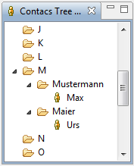
A Simple Tree Model
RootNode
FirstLetterNode
…
FirstLetterNode
LastNameNode
Contact
LastNameNode
Contact
FirstLetterNode
…

Slide 35
ITreeContentProvider Example
The Content Provider contains logic to provide its callers with the tree’s domain objects
For example the children of a given tree node:
private final Object[] emptyArray = new Object[] {};
public Object[] getChildren(Object parent) {
if (parent instanceof RootNode) {
return ((RootNode) parent).getChildren();
} else if (parent instanceof FirstLetterNode) {
return ((FirstLetterNode) parent).getChildren();
} else if (parent instanceof LastNameNode) {
return ((LastNameNode) parent).getChildren();
}
return emptyArray;
}

Slide 36
ITreeContentProvider Example cont.
Plus the logic for providing a node’s parent:
public Object getParent(Object element) {
if (element instanceof FirstLetterNode) {
return model.getRoot();
} else if (element instanceof LastNameNode) {
return model.getParent((LastNameNode) element);
} else if (element instanceof Contact) {
return model.getParent((Contact) element);
}
return null;
}
As you can see here the Content Provider has to deal with all kinds of domain objects that build up the tree structure
The use of an AdapterFactory will improve this design

Slide 37
AdapterFactory
Implemetations of IAdapterFactory can be registered with the platform
Such a factory provides adapters for given base classes
In our example for Contact, FirstLetterNode, LastName-Node and RootNode
These base classes do NOT have to implement IAdaptable themselves because internally the Factory will use implementations of IWorkbenchAdapter

Slide 38
WorkbenchAdapter
In most cases domain specific classes can be handled by using implementations of IWorkbenchAdapter
IWorkbenchAdapter is a combination of a Label- and a Content-Provider
It allows you to present domain data in the UI without having to know the concrete implementation type of the object that provides the data
Concrete implementation types will be Contact, FirstLetterNode, LastNameNode and RootNode
For each of your domain classes your AdapterFactory will wrap an implementation of IWorkbenchAdapter

Slide 39
IWorkbenchAdapter Example
The IWorkbenchAdapter implementation for the domain class Contact in your AdapterFactory will look like this:
private IWorkbenchAdapter contactAdapter = new IWorkbenchAdapter() {
private final Object[] emptyArray = new Object[]{};
public Object getParent(Object o) {
return treeModel.getParent((Contact)o);
}
public String getLabel(Object o) {
return ((Contact)o).getLastName();
}
public ImageDescriptor getImageDescriptor(Object object) {
return AbstractUIPlugin.imageDescriptorFromPlugin( Activator.PLUGIN_ID, "icons/person.gif");
}
public Object[] getChildren(Object o) {
return emptyArray;
}
};

Slide 40
Getting the Adapters
In order to hand out the adapters the AdapterFactory provides a method getAdapter(Object, Class):
public Object getAdapter(Object adaptableObject, Class adapterType) {
if (adapterType == IWorkbenchAdapter.class
&& adaptableObject instanceof Contact)
return contactAdapter;
if (adapterType == IWorkbenchAdapter.class && adaptableObject instanceof LastNameNode)
return lastNameNodeAdapter;
// code for FirstLetterNode, RootNode
return null;
}
public Class[] getAdapterList() {
return new Class[] { IWorkbenchAdapter.class };
}

Slide 41
Registering AdapterFactory in TreeViewer
Your AdapterFactory is registered with the platform by using the AdapterManager API:
treeViewer = new TreeViewer(parent);
treeViewer.setLabelProvider(new WorkbenchLabelProvider());
treeViewer.setContentProvider(new BaseWorkbenchContentProvider());
TreeModel treeModel = new TreeModel();
IAdapterFactory adapterFactory = new ContactAdapterFactory(treeModel);
IAdapterManager adapterManager = Platform.getAdapterManager();
adapterManager.registerAdapters(adapterFactory, Contact.class);
// also register LastNameNode, FistNameNode, RootNode here
RootNode root = treeModel.getRoot();
treeViewer.setInput(root);

Slide 42
Benefits
Loose coupling of domain objects with UI related objects
No need to explicitly write Label- and ContentProviders due to reuse of WorkbenchLabelProvider and BaseWorkbench-ContentProvider
AdapterFactory might provide several different adapters like IWorkbenchAdapter or IPropertySource

Slide 43
Lab Tasks
Create a new project net.eclipsetraining.contacts.ui. mytreeview
Reuse the tree model from the project net.eclipsetraining. contacts.ui.treeview
Implement a ContactAdapterFactory with adapters for all tree model elements
Create a JFace TreeViewer and test both the AdapterFactory approach vs. the standard Label- and ContentProvider mechanism

Slide 44
Optional Tasks
Create a IPropertySource implementation for Contacts
Add an adapter for IPropertySource and Contacts to your ContactsAdapterFactory
Add the standard Properties View to the contacts manager application
Hint: Add the project org.eclipse.ui.views to your contacts.product launch configuration

Slide 45
Further Information
In Kai Tödter’s MP3 Manager, you find examples for Adapter Factories in the Views project, see http://max-server.myftp.org/trac/mp3m
EclipseZone article by Jeffrey Ricker, see http://eclipse.dzone.com/articles/eclipse-adapters-hand-hand-hol?page=0%2C0

Slide 46
Agenda
Introduction
Plug-in philosophy
Jobs
Adapters
JFace Wizards
Data Binding
Virtual Trees and Tables
Defining Extension Points
Customizing the Look and Feel
Help System
p2 - Provisioning and Update
Headless build
Wrap-up

Slide 47
WizardDialog / Wizard
The Wizard API is provided by JFace
WizardDialog is a top level dialog for a wizard
It supports standard wizard buttons and controls the enablement of them
Your wizard class - implementing IWizard - controls overall behavior and logic of the wizard (title text and image, help button, etc.)
Typically you extend the Wizard class and
Create and add wizard pages using addPage(IWizardPage)
Implement the behavior that occurs when the user presses the finish button by overriding performFinish()

Slide 48
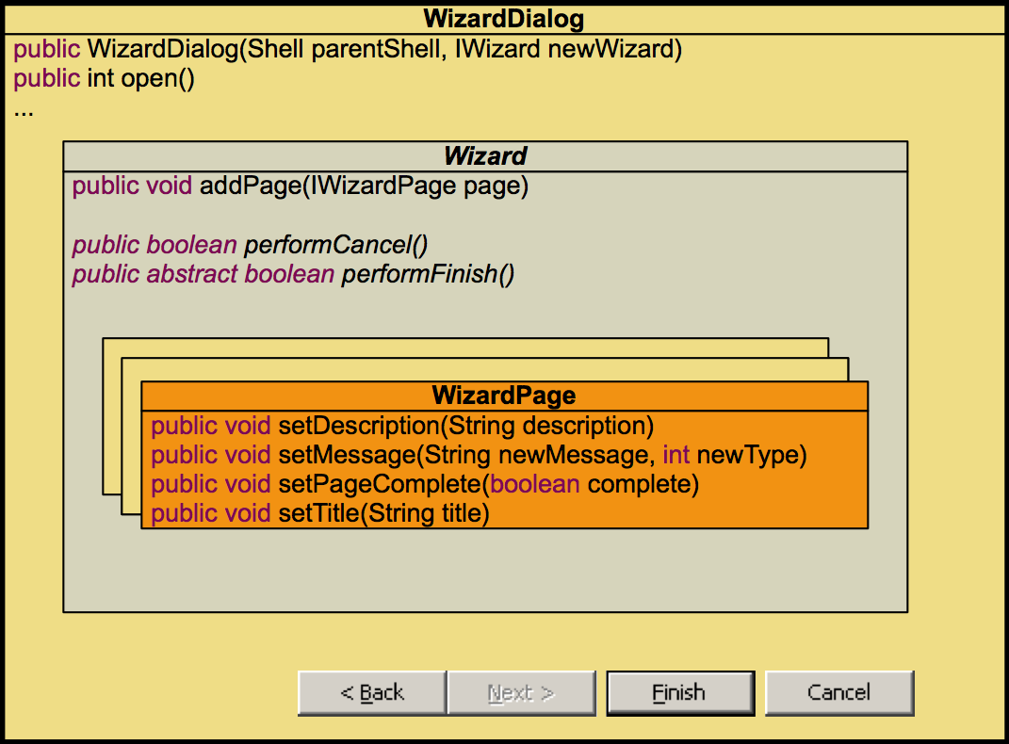
JFace Wizards API

Slide 49
Wizard Page I
Single pages are created by extending the WizardPage class
You need to override the createControl(Composite parent) method to create the content of the wizard page
Create a control that will hold your widgets and set it to the wizard page:
@Override
public void createControl(Composite parent) {
Composite cmp = new Composite(parent, SWT.NONE);
// add your widgets to the composite
…
setPageComplete(false);
setControl(cmp);
}

Slide 50
Wizard Page II
Your input widgets should be attached to a ModifyListener that
picks up user input,
calls your validation logic and
calls the framework method setPageComplete() to indicate whether the current page is complete:
@Override
public void createControl(Composite parent) {
…
final ModifyListener modifyListener = new ModifyListener() {
public void modifyText(ModifyEvent aE) {
setPageComplete(validateMyPage());
}
};
myTextWidget.addModifyListener(modifyListener);
…
}

Slide 51
Wizard Page III
Validation Errors can be indicated to the framework by calling setErrorMessage(String errorMessage):
The error messages will be shown in the WizardDialog
protected boolean validateMyPage() {
final boolean isComplete = … // your input validation here
if(!isComplete)
setErrorMessage(„Please provide more data!“);
else
setErrorMessage(null);
return isComplete;
}

Slide 52
Workbench Wizard Extension Points
The workbench defines three wizard related extension points:
org.eclipse.ui.newWizards
org.eclipse.ui.importWizards
org.eclipse.ui.exportWizards
You can contribute to these extension points and define your own wizard based operations for new, import and export functionality
If you contribute a wizard you need to provide your wizard implementation class
The WizardDialog itself is instantiated by the workbench

Slide 53
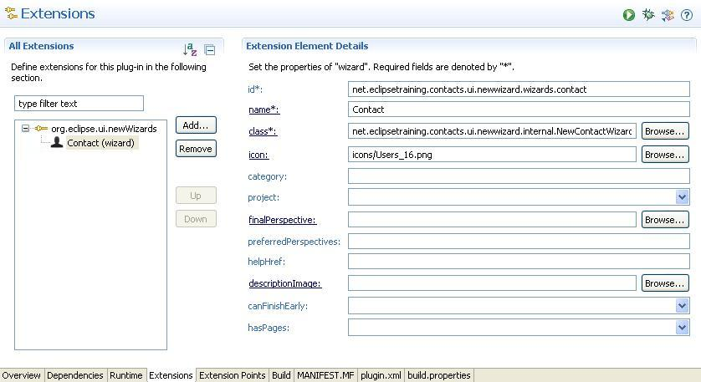
org.eclipse.ui.newWizards

Slide 54
Lab tasks I
Add the workbench’s "New" command to the main menu and the toolbar of your application:
Use org.eclipse.ui.menu extension point for declarative placement
Command id: org.eclipse.ui.newWizard
Add an extension to org.eclipse.ui.newWizards and contribute your wizard
Use the extension editor to create a class for your wizard

Slide 55
Lab tasks II
Create a wizard page class extending org.eclipse.jface. wizard.WizardPage and add it to your wizard
Add widgets to your page in order to gather the user‘s input
Implement the performFinish() method of your wizard
Retrieve the data entered on the page
Create a new contact by calling addContact(Contact)of the ContactsRepository
Make your WizardPage react if data is invalid:
Warn the user with a message and prevent the wizard from being finished.

Slide 56
Agenda
Introduction
Plug-in philosophy
Jobs
Adapters
JFace Wizards
Data Binding
Virtual Trees and Tables
Defining Extension Points
Customizing the Look and Feel
Help System
p2 - Provisioning and Update
Headless build
Wrap-up

Slide 57
Data Binding
Data Binding allows you to bind and synchronize arbitrary values
This functionality is provided by three Plug-ins:
org.eclipse.core.databinding
org.eclipse.core.databinding.beans
org.eclipse.jface.databinding
They are included in RCP since version 3.3
Improvements in 3.4 and 3.5

Slide 58
Observable values
A value is represented by IObservableValue. An IObservable-Value object provides an API for
Returning its value: getValue()
Setting a value: setValue(Object)
Observing a value: addValueChangeListener(IValueChangeListener) removeValueChangeListener(IValueChange-Listener)
For common cases IObservableValue implementations are created using observable factory classes
For SWT widgets: SWTObservables
For Java Beans with PropertyChangeSupport: BeansObservables
For regular Java Objects: PojoObservables

Slide 59
Observing API examples
Observing different properties of a SWT widget, e.g.
Text: SWTObservables.observeText(widget, SWT.Modify)
Enabled: SWTObservables.observeEnabled(widget)
Editable: SWTObservables.observeEditable(widget)
Observing a Pojo bean property:
PojoObservables.observeValue(object, "myProperty")
Return values are instances of IObservableValue

Slide 60
DataBindingContext
A DataBindingContext manages a set of bindings
Use it to
bind observables: bindValue()
update values on request: updateModels() / updateTargets()
query bindings: getBindings()
query validation status: getValidationStatusProviders()

Slide 61
Bindings I
A binding connects two Observables and makes sure their values are synchronized. Bindings are created by calling
bindValue(IObservableValue targetObservable,
IObservableValue modelObservable,
UpdateValueStrategy targetToModel,
UpdateValueStrategy modelToTarget);
Initially the value is copied from the modelObservable to the targetObservable

Slide 62
Bindings II
UpdateValueStrategy for targetToModel and modelToTarget allows to customize the binding, for example:
updatePolicy: defines when update is done (never, on request, on changes)
converter: conversion of values if the model type differs
validator: define rules for checking the value before changing values
One problem left…
From which thread should objects be accessed?

Slide 63
Realms
The solution: Databinding’s concept of Realms
A Realm defines a context from which objects must be accessed
SWT controls must be accessed from the display thread, therefore SWT observables use the SWT realm by default
Most Observables and Validators use the default Realm which needs to be set by the developer:
Realm.runWithDefault(realm, runnable)

Slide 64
Setting up JFace Databinding
The code for setting up Databinding in order to bind a Pojo as model to an SWT widget as target looks like this:
Realm.runWithDefault(
SWTObservables.getRealm(parent.getDisplay(),
new Runnable()
{
public void run() {
DataBindingContext bc = new DataBindingContext();
bc.bindValue(
SWTObservables.observeText(myTextWidget, SWT.Modify),
PojoObservables.observeValue(myPojoBean, “myProperty”),
null,
null);
}
}
);

Slide 65
Validators
Validators can be used on both model and target sides
Validators implement IValidator
Method validate returns an IStatus
Validators can be set in the UpdateStrategy

Slide 66
Example Validator
class StringRequiredValidator implements IValidator {
public IStatus validate(Object value) {
if (value instanceof String) {
String text = (String) value;
if (text.trim().length() == 0) {
return ValidationStatus.error(“MY ERROR TEXT”);
}
}
return Status.OK_STATUS;
}
}

Slide 67
Setting the Validator
bindingContext.bindValue(
SWTObservables.observeText(firstNameText, SWT.Modify),
PojoObservables.observeValue(getContact(), "firstName"), new UpdateValueStrategy().setAfterConvertValidator( new StringRequiredValidator( "Please enter first name")), updateOnRequest);

Slide 68
Converters
Converters can be used on both model and target sides
Converters implement IConverter
Tipp: Just extend class Converter
Method convert returns an Object
Converters can be set in the UpdateStrategy

Slide 69
Example Converter
public class UmlautConverter extends Converter {
public UmlautConverter() {
super(String.class, String.class);
}
public Object convert(Object fromObject) {
if (fromObject == null || !(fromObject instanceof String)) {
return "";
}
StringBuilder result = new StringBuilder();
String input = (String) fromObject;
for(int i=0; i<input.length();i++ ) {
if(input.charAt(i) == 'ö')
result.append("oe");
else
result.append(input.charAt(i));
}
return result;
}
}

Slide 70
Lab Tasks
Experiment with Data Binding by binding two Text fields together in your ContactEditor.
Use Data Binding to bind the Text values in your ContactEditor to the Contact object.
Find a way to automatically update the dirty flag of the editor using the DataBindingContext API.
Optional tasks: Try out validation and conversion of values.

Slide 71
Further information
http://wiki.eclipse.org/JFace_Data_Binding/Snippets
http://wiki.eclipse.org/Category:Data_Binding
http://www.ibm.com/developerworks/opensource/library/os-ecl-jfacedb1/
http://www.ibm.com/developerworks/edu/os-dw-os-ecl-jfacedb2.html
http://www.ibm.com/developerworks/edu/os-dw-os-ecl-jfacedb3.html

Slide 72
Agenda
Introduction
Plug-in philosophy
Jobs
Adapters
JFace Wizards
Data Binding
Virtual Trees and Tables
Defining Extension Points
Customizing the Look and Feel
Help System
p2 - Provisioning and Update
Headless build
Wrap-up

Slide 73
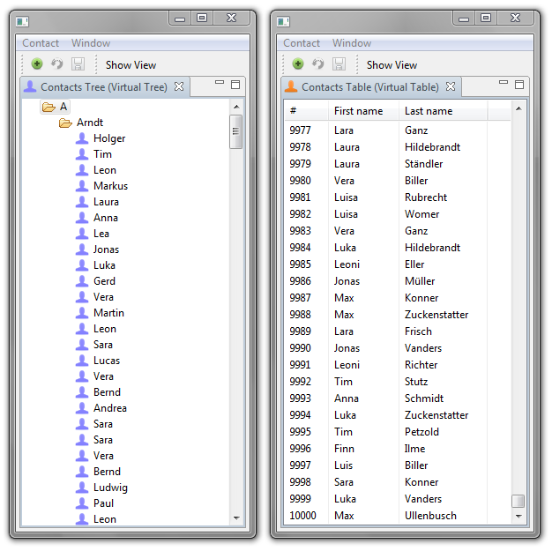
Virtual Trees & Tables

Slide 74
Challenges
Data intensive applications are posing some serious challenges to a programmer:
Huge amount of domain specific data has to be displayed in a tree or table
Data for the whole tree or table needs either
Too much memory or
Takes too much time to create upfront
or even both

Slide 75
Virtual Trees and Tables
Solution: Virtual Trees & Tables
Create model data and tree/table items only when they are really needed (e.g. displayed)
Keep only the part of the data in memory that is currently displayed
Free model data und tree/table items if they are no longer displayed

Slide 76
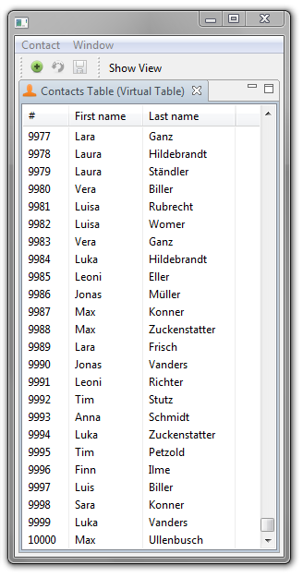
A Virtual Table

Slide 77
Virtual TableViewer initialization
In order to create a virtual table viewer you need to go through some defined steps:
public void createPartControl(Composite parent) {
TableViewer tableViewer =
new TableViewer(parent, SWT.VIRTUAL | SWT.BORDER | SWT.V_SCROLL);
Table table = tableViewer.getTable();
TableColumn column = new TableColumn(table, SWT.NONE, 0);
column.setText(“#");
column.setWidth(50);
// …
tableViewer.setItemCount(ContactsRepositoryFactory. getContactsRepository().getAllContacts().size();
tableViewer.setContentProvider(new LazyContentProvider());
tableViewer.setLabelProvider(new TableLabelProvider());
tableViewer.setUseHashlookup(true);
tableViewer.setInput(null);
}

Slide 78
LazyContentProvider
The virtual table viewer needs to be provided with a ILazyContent-Provider implementation:
class LazyContentProvider implements ILazyContentProvider {
public void inputChanged(Viewer viewer, Object oldInput,
Object newInput) {
this.viewer = (TableViewer) viewer;
this.viewer.getTable().addListener(SWT.SetData, new Listener() {
public void handleEvent(Event event) {
TableItem item = (TableItem) event.item;
// compute top and bottom index and clear portions // of the table to clean up memory
}
}
}
public void updateElement(int index) {
Contact contact = getAllContacts().get(index);
viewer.replace(contact, index);
}
}

Slide 79
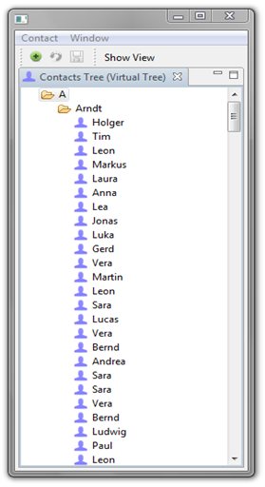
A Virtual Tree

Slide 80
Virtual TreeViewer initialization
In order to create a virtual tree viewer you need to go through some defined steps:
public void createPartControl(Composite parent) {
treeViewer = new TreeViewer(parent, SWT.VIRTUAL);
getSite().setSelectionProvider(treeViewer);
treeViewer.setLabelProvider(new TreeLabelProvider());
treeViewer.setContentProvider( new LazyTreeContentProvider(treeViewer));
treeViewer.setUseHashlookup(true);
TreeModel treeModel = new TreeModel();
RootNode root = treeModel.getRoot();
treeViewer.setInput(root);
treeViewer.setChildCount(root, root.getChildCount());
}

Slide 81
ILazyContentProvider
The virtual tree viewer needs to be provided with a ILazyTree-ContentProvider implementation:
class TreeContentProvider implements ILazyTreeContentProvider {
public void updateElement(Object parent, int index) {
if (parent instanceof RootNode) {
FirstLetterNode child =
((RootNode) parent).getChildAt(index);
treeViewer.replace(parent, index, child);
treeViewer.setChildCount(child, child.getChildCount());
} else if (parent instanceof FirstLetterNode) {
// …
}
//…
}
}

Slide 82
Lab Tasks
Create a virtual table to display a huge list of Contacts
Initialize the DummyContactsRepository with 10.000 random Contacts
Hint: Use java.util.Random
Implement a Content Provider that implements ILazyContent-Provider
Implement the updateElement() method properly

Slide 83
Optional Tasks
Implement the handleEvent() method in your LazyContent-Provider to clean up table elements that are no longer needed
Hint: Take a look in the project net.eclipsetraining.contacts. ui.virtualviews

Slide 84
Further Information
In Kai Tödter’s MP3 Manager you will find examples for both virtual trees and tables, see http://max-server.myftp.org/trac/mp3m
Eclipse Corner Article, see http://www.eclipse.org/articles/Article-SWT-Virtual/Virtual-in-SWT.html

Slide 85
Agenda
Introduction
Plug-in philosophy
Jobs
Adapters
JFace Wizards
Data Binding
Virtual Trees and Tables
Defining Extension Points
Customizing the Look and Feel
Help System
p2 - Provisioning and Update
Headless build
Wrap-up

Slide 86
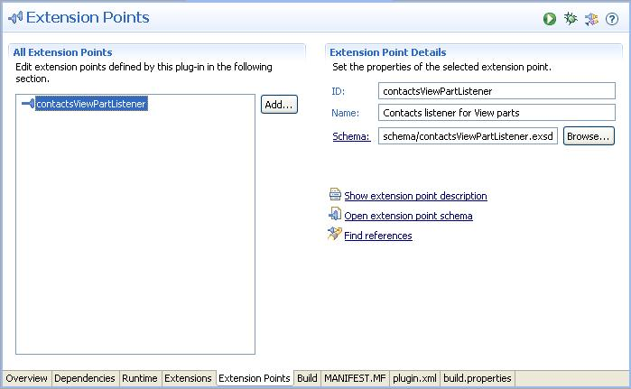
Defining Extension Points

Slide 87
Extensions
Up to now all entries in plugin.xml reflected extensions to predefined extension points – e.g. org.eclipse.ui.views for contributing a view:
But there is an opposite side to this: the definition of the extension point org.eclipse.ui.views in the org.eclipse.ui Plug-in…
<extension
point="org.eclipse.ui.views">
<view
category="net.eclipsetraining.contacts.ui.views.categories.contacts"
class="net.eclipsetraining.contacts.ui.listview.internal.ListView"
icon="icons/Users_16.png"
id="net.eclipsetraining.contacts.ui.listview.views.list"
name="Contact List"
restorable="true">
</view>
</extension>

Slide 88
Extension Points
In the org.eclipse.ui Plug-in you will find the following entry in plugin.xml:
This entry defines the extension point org.eclipse.ui.views
It points towards an XML Schema document named views.exsd located in a folder schema
How do the details of this mechanism look like and how can you use it to make your own Plug-ins extensible?
<extension-point id="views" name="%ExtPoint.views" schema="schema/views.exsd"/>

Slide 89
Extension Point Infrastructure I
The extension point infrastructure is the Eclipse-specific way of extending Plug-ins with code and/or data
It is completely open to your own usage: nothing prevents you from using it to define your own extension points
It is based upon XML and XML Schema and empowers you to
Define the XML structure of an extension point
Interact with the Extension Point Registry at runtime through a Java API

Slide 90
Extension Point Infrastructure II
An extension point definition points towards an XML Schema document which defines the contract of the extension point
It describes the valid XML structure that needs to be adhered to when Contributors want to provide an extension
Additionally XML Schema offers a means of associating data types to the XML nodes

Slide 91
Relationship Extension Point / Extension
Defining Plug-in
is dependant on
*
Extending Plug-in
declares
declares
Extension Point
contributes to
*
Extension
sets a contract
provides some functionality
Interface
implements
*
Java class (Code)

Slide 92
Steps for defining and using Extension Points
Create the extension point in your Plug-in
Design the XML Schema associated with it
If you want to contribute code: define a Java interface to which contributed classes should adhere to
After doing so Plug-ins can contribute to your extension point if they provide valid XML in their plugin.xml
Use the extension point infrastructure’s API to do something with the provided extensions
At runtime they will be accessible in the Extension Point Registry

Slide 93
Creating Extension Points
The extension point ID does not contain the Plug-in ID
The extension point is designed by editing its Schema

Slide 94
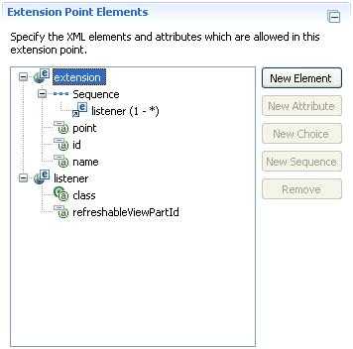
Designing Extension Points I
XML Schema is defined using
Elements
Attributes
Compositors
Root element extension is mandatory
Elements and Sub-Elements are structured using compositors
Sequence of Sub-Elements
Sub-Element of extension

Slide 95
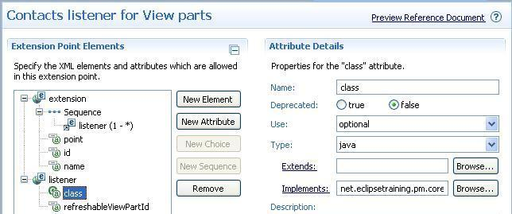
Designing Extension Points II
The XML nodes that you define in the Schema editor can be
Optional or required
Typed (e.g. java)

Slide 96
Contributing to Extension Points
If a Plug-in adds a contribution to the new extension point plugin. xml will contain an entry like this:
As defined in the XML Schema the extension has
One listener Sub-Element
Which has two attributes class (of type java) and refreshableViewPartId (of type String)
<extension
point="net.eclipsetraining.contacts.core.contactsViewPartListener">
<listener
class="net.eclipsetraining.contacts.ui.listview.internal.ListViewContactsListener"
refreshableViewPartId="net.eclipsetraining.contacts.ui.listview.views.list">
</listener>
</extension>

Slide 97
Process the available Extensions
At runtime you will now be able to access the contributed extensions and do something with their data:
IExtensionRegistry registry = Platform.getExtensionRegistry();
IConfigurationElement[] cef = registry.getConfigurationElementsFor(
"net.eclipsetraining.contacts.core",
"contactsViewPartListener");
for (IConfigurationElement ce : cef) {
IContactsViewPartListener listener = (IContactsViewPartListener)
ce.createExecutableExtension("class");
String listenerPartId = ce.getAttribute("refreshableViewPartId")
// do something with listener and listenerPartId
}

Slide 98
Lab Tasks I
We need a means of automatically reacting to changes in the DummyContactsRepository
Create an Interface IContactsListener that reflects this need:
onCreate(Contact)
onUpdate(Contact)
onDelete(Contact)
Create and design an extension point called contactsListener that accepts a Java class of the IContactsListener type

Slide 99
Lab Tasks II
Implement code that accesses the Extension Point Registry and registers the contributed listeners with the contacts repository
Hint: add a private ListenerList to the repository to which the contributed listeners can be added to
Add logic that notifies the registered listeners after create/update/ delete operations

Slide 100
Optional Tasks I
Create and design an extension point contactsViewPart Listener that will notify a view when changes occur in the contacts repository
Check the previous screenshots for a bit of inspiration on this topic!
Hint: there is an API in RCP that allows you to query for views:
PlatformUI
.getWorkbench()
.getActiveWorkbenchWindow()
.getActivePage()
.findView(VIEW_ID);

Slide 101
Optional Tasks II
Add documentation to your extension point using the Schema Editor.
You can preview the documentation with the "Preview Reference Document" command (Schema Editor -> Overview page -> General Information -> Context Menu -> Preview Reference Document)

Slide 102
Agenda
Introduction
Plug-in philosophy
Jobs
Adapters
JFace Wizards
Data Binding
Virtual Trees and Tables
Defining Extension Points
Customizing the Look and Feel
Help System
p2 - Provisioning and Update
Headless build
Wrap-up

Slide 103
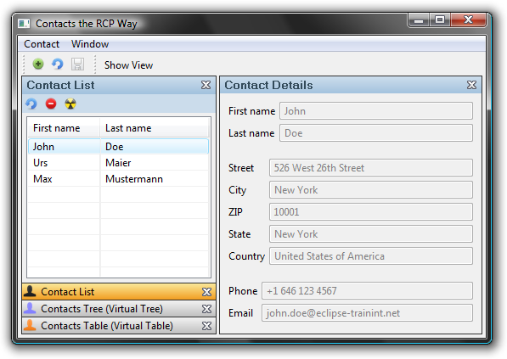
Customizing the Look & Feel

Slide 104
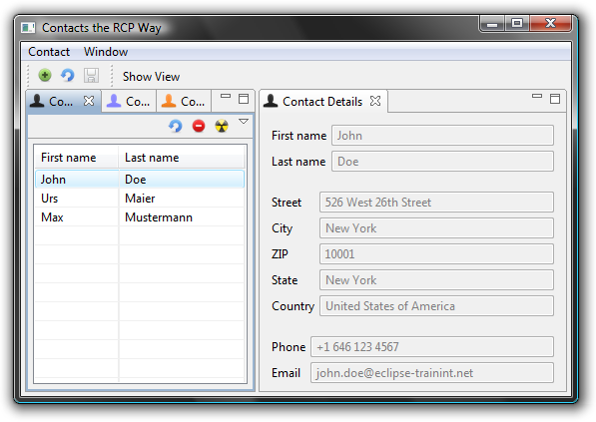
Default Vista Look & Feel
Looks nice ☺ … but doesn’t it look a bit like the Eclipse IDE?

Slide 105
Custom Presentation
Looks differently compared to the Eclipse IDE. Can increase application usability.

Slide 106
What is a Presentation?
Usually RCP applications contain Views and Editors
These Views and Editors are called Parts
The Presentation customizes the layout and Look & Feel of areas containing one or more parts
Drawback: Not the whole application's Look & Feel can be customized with the Presentation API
No Look & Feel skinning like in Swing
Presentation can provide custom widgets and behavior

Slide 107
Presentation Responsibilities
Control the layout and visibility of…
Parts
Menus & Toolbars
Drag & Drop regions
Create the Look & Feel for part stacks…
Tabs
Title
Buttons (Close, Maximize, Minimize)
Borders

Slide 108
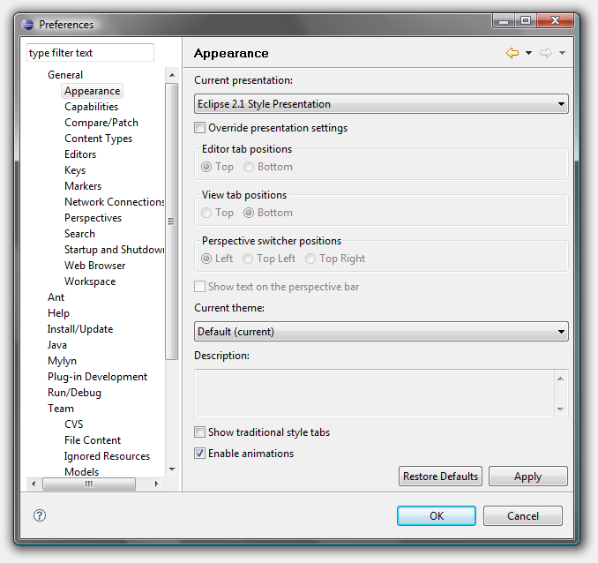
Presentation Activation (Eclipse IDE)
Go to “General/Appearance” in the preferences
Choose a Presentation (e.g. “2.1 Style”) and restart Eclipse

Slide 109
Activation with Preference
Create <some_name>.ini file with content:
org.eclipse.ui/presentationFactoryId=<ID>
ID is the Presentation id, e.g. for the “2.1 Style”:
org.eclipse.ui.internal.r21presentationFactory
Specify program arguments:
-plugincustomization <some_name>.ini
Or create a default file: plugin_customization.ini or preferences.ini
Advantage: Those will be detected by the launcher automatically

Slide 110
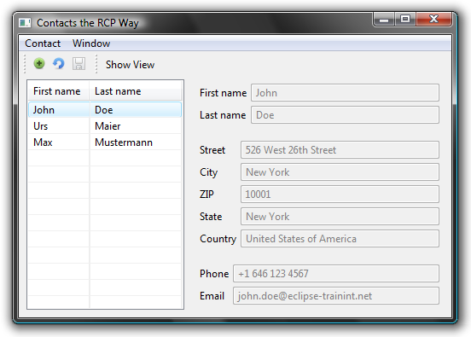
A Minimal Presentation
A Presentation that only displays a Part
No borders, tabs, menus
Only the top Part of the stack is shown

Slide 111
Creating a “Minimal Presentation”
Create a Presentation factory
Extend org.eclipse.ui.presentationFactories
Provide class, id and name of your Presentation:
<extension point= "org.eclipse.ui.presentationFactories" >
<factory
class=“net.eclipsetraining.contacts.ui.presentation.MinimalPresentationFactory“
id=“net.eclipsetraining.contacts.ui.presentation.MinimalPresentationFactory“
name="Minimal Presentation" />
</extension>

Slide 112
AbstractPresentationFactory
The abstract super class for your Presentation factory has the following API that needs to be overridden:
public abstract class AbstractPresentationFactory {
public abstract StackPresentation createEditorPresentation(
Composite parent, IStackPresentationSite site);
public abstract StackPresentation createViewPresentation(
Composite parent, IStackPresentationSite site);
public abstract StackPresentation createStandaloneViewPresentation(
Composite parent, IStackPresentationSite site, boolean showTitle);
}

Slide 113
MinimalPresentationFactory
A minimal factory implementation looks like this:
public class MinimalPresentationFactory extends AbstractPresentation-
Factory {
public StackPresentation createEditorPresentation( Composite parent, IStackPresentationSite site) {
return new MinimalPresentation(parent, site);
}
public StackPresentation createViewPresentation( Composite parent, IStackPresentationSite site) {
return new MinimalPresentation(parent, site);
}
public StackPresentation createStandaloneViewPresentation(
Composite parent, IStackPresentationSite site, boolean showTitle) {
return new MinimalPresentation(parent, site);
}
}

Slide 114
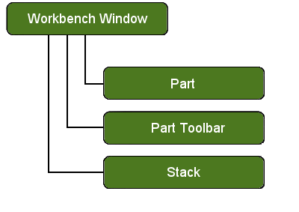
Widget Issues
Widget hierarchy
The Parts are not children of the
Presentation!
Parts and Part toolbars are parented
by the workbench
Allows moving parts between stacks
A Presentation should not use the Part’s control
It should use instead: IPresentablePart.setBounds() and IPresentablePart.setVisible()

Slide 115
Creating a real Presentation
Useful for…
Corporate design or Look & Feel
Product branding & product families
Application usability
Think of…
Drawing borders, visible focus
Buttons (close, minimize, maximize)
Tab Look & Feel
Menus (System, View and Part)

Slide 116
Contacts Manager Presentation
Design Goals
Title area with no icons, but gradient fill
Image-based close button for closable Parts
Button-like tabs, with whole Part width
Different gradient fills for selections
Roll-over effect
Since we have a title area, tabs should only be visible if there’s more than one tab

Slide 117
Contacts Presentation Demo

Slide 118
Lab Tasks
Launch your Contacts Manager application with the new Presentation
Hint: Make sure that plugin_customization.ini in the project net.eclipsetraining.contacts.product contains the following data:
Be creative and customize the Presentation
E.g. change the color gradients
org.eclipse.ui/presentationFactoryId= \\ net.eclipsetraining.contacts.ui.presentation.PresentationFactory

Slide 119
Optional Tasks
Render the tabs of the Presentation at the top of the View instead of the bottom

Slide 120
What else could be customized?
Shapes of windows
E.g. non-rectangular shapes
Different icon sets
This is not a trivial task but this can be done using Equinox Transforms, see http://wiki.eclipse.org/Equinox_Transforms

Slide 121
Further Information
In Kai Tödter’s MP3 Manager you will find an example of a similar presentation, see http://max-server.myftp.org/trac/mp3m
EclipseCon 2005 Presentation, see http://dev.eclipse.org/viewcvs/index.cgi/*checkout*/org.eclipse.ui.examples.presentation/eclipsecon2005-presentationsAPI.ppt?rev=1.1&content-type=application/powerpoint
http://wiki.eclipse.org/index.php/User_Interface_Guidelines

Slide 122
Agenda
Introduction
Plug-in philosophy
Jobs
Adapters
JFace Wizards
Data Binding
Virtual Trees and Tables
Defining Extension Points
Customizing the Look and Feel
Help System
p2 - Provisioning and Update
Headless build
Wrap-up

Slide 123
Help Books
Help is added in the form of help books
Each help book appears in Eclipse's help system
Each help book has a table of contents (TOC)
TOCs files can be registered with the platform by contributing to org.eclipse.help.toc extension point:
<extension point="org.eclipse.help.toc">
<toc file="toc.xml" primary="true"/>
</extension>

Slide 124
Help Topics
The help content itself is defined in help topics
A help topic can then be referenced in the table of contents
Topic content is defined in HTML:
<?xml version="1.0" encoding="UTF-8"?>
<?NLS TYPE="org.eclipse.help.toc"?>
<toc label="My Application" topic="html/toc.html">
<topic label="Getting Started" href="html/gettingstarted.html">
<topic label="Installing" href="html/installing.html"/>
</topic>
</toc>

Slide 125
Help Modes
In order to present this HTML-based help content to clients a web server is needed
Two different help configurations are available
Local plug-ins based help (default)
Remote help server

Slide 126
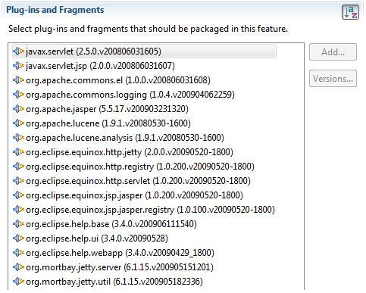
Local Plug-in based Help
Local help support is not included in the core RCP
The Plug-ins are grouped in the org.eclipse.help feature:

Slide 127
Context Sensitive Help I
Context sensitive help can be defined for:
Menus
Controls
It can be enabled programmatically or declaratively
Hint: it does not make sense to associate help with controls which are unable to receive the focus
In order to enable context sensitive help you have to contribute to org.eclipse.help.contexts
<extension point="org.eclipse.help.contexts">
<contexts file="myContextSensitiveHelp.xml" />
</extension>

Slide 128
Context Sensitive Help II
This contribution points to an XML file in which context sensitive help is configured
The contents of this file look like this:
<contexts>
<context id="contactsView" title=“Contacts View">
<description>This is the ...</description>
<topic href="html/contextsensitive/tableViewer.html“ label=" The contacts table"/>
</context>
</contexts>

Slide 129
Context Sensitive Help III
You need to register the UI control, on which the context sensitive help should be available, with the Eclipse Help System and associate it with the contextId
When F1 is pressed, the corresponding help topics are shown
The contextId is composed of the Plug-in ID of the Plug-in where there context file is located plus the context name specified in that file
IWorkbenchHelpSystem helpSystem
= PlatformUI.getWorkbench().getHelpSystem();
String contextId =
"net.eclipsetraining.contacts.ui.help.contactsView";
helpSystem.setHelp(control, contextId);

Slide 130
Active Help 1
Active help enables you to call Java code from your HTML-based help pages
Include the first Java Script snippet in your HTML page’s head, the second one in the page’s body:
<script language="JavaScript" src="PLUGINS_ROOT/org.eclipse.help/ livehelp.js"></script>
<a href='javascript:liveAction(
PLUGIN_ID,
JAVA_CLASS,
STRING_PARAMETER)'>Click here for a Message.</a>

Slide 131
Active Help 2
The first parameter to the liveAction function is the ID of the plug-in that provides the code to call
The second parameter points to a package-qualified Java class that will be called
With the third parameter a string can be passed to the Java class
The class ActiveHelpOpenDialogAction must implement org.eclipse.help.ILiveHelpAction and synchonize with the UI Thread
<a href='javascript:liveAction(
"net.eclipsetraining.contacts.ui.help",
"net.eclipsetraining.contacts.ui.help.internal.
ActiveHelpOpenDialogAction",
"test")'>Click here for a Message.</a>

Slide 132
Lab Tasks
Add a help book to your application
Implement context sensitive help
Search for the Active Help documentation and implement it

Slide 133
Agenda
Introduction
Plug-in philosophy
Jobs
Adapters
JFace Wizards
Data Binding
Virtual Trees and Tables
Defining Extension Points
Customizing the Look and Feel
Help System
p2 - Provisioning and Update
Headless build
Wrap-up

Slide 134

The Next Generation – P2
RCP-P2

Slide 135
p2 Overview
p2 is the new Eclipse provisioning system
Introduced with version 3.4
Replaced the old update manager
Fixes many of the update manager’s flaws
Has many new features (see next slides)

Slide 136
P2 Features (1)
Cleaner end-user workflows
Faster downloads through multi-threading
Installers can be run as a regular Java application or using Java Web Start
Can manage complete installation (.exe, .ini, etc.)
Can manage and update an Eclipse/RCP instance without running it

Slide 137
P2 Features (2)
Automatically picks the best available mirror
Automatic retry of downloads
Sharing of plug-ins across multiple eclipse instances (bundle pooling)
Easy creation of headless and custom update user interfaces
Validates plug-in inter-dependencies

Slide 138
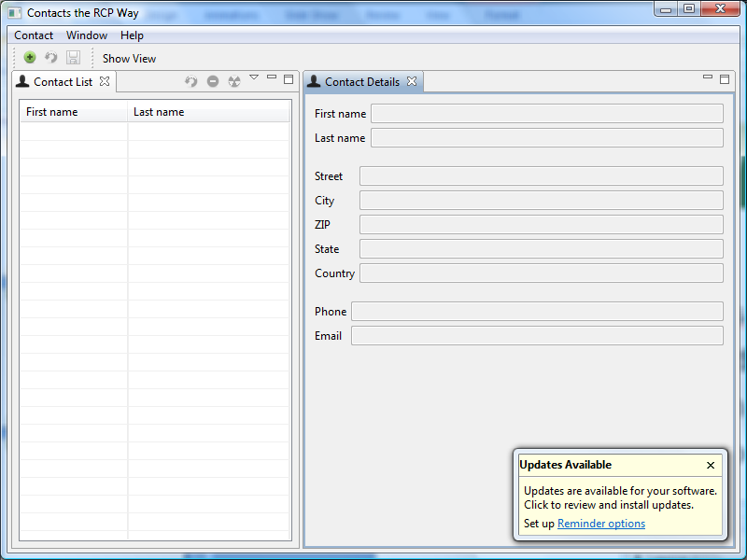
P2 & RCP – What are the Goals?
Greater Goals
The benefits of RCP but no complicated management
Enable Enterprise Client Management
Easy installation and easy updates
Revert to a previous version
Installation
Roll out across the network
Use the P2 Installer
Update
Update from within the client
Perform stealth updates
138

Slide 139
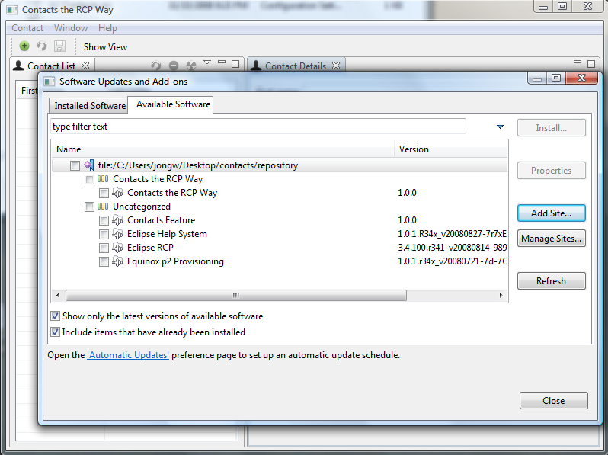
Easy Management with Features I
A Feature…
Is a list of Plug-ins, effectively it groups them
Can be used in product definitions
Can be used to modularize our application
139

Slide 140
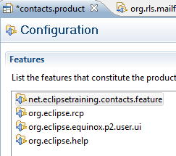
Easy Management with Features II
Our application consists of the following features:
net.eclipestraining.contacts.feature
Contains all our domain Plug-ins
org.eclipse.rcp
Contains all RCP Plug-ins
org.eclipse.equinox.p2.user.ui
Contains the update UI
org.eclipse.help
Contains the plug-ins of the help system
140

Slide 141
How to P2-ify the application
Export the product and generate a Metadata repository
Point your product to the generated repository
Change the product’s code
Re-export the product and re-generate the Metadata repository
Update the product from the running application
141

Slide 142
Setting the Default p2 Update Site
Use touchpoint instructions
Create file p2.inf in the plug-in of your product configuration
Example:
instructions.configure=\ addRepository(type:0,location:http${#58}//max-server.myftp.org/mp3m/repository);\
addRepository(type:1,location:http${#58}//max-server.myftp.org/mp3m/repository);

Slide 143
Lab Tasks I: Prepare
Step 1: Add the help menu and the about dialog in the commands Plug-in:
Add the command org.eclipse.ui.help.aboutAction to the help menu
Run and check if it is available
Step 2: Create a Feature project if you did not already do so:
File → New… → Project… → Feature Project
ID: net.eclipsetraining.contacts.feature
Version: 1.0.0
Branding Plug-in: net.eclipsetraining.contacts.application
Step 3: Add all our Plug-ins to the list in the “Plug-ins” tab plus org.eclipse.ui.views and org.eclipse.ui.forms
143

Slide 144
Lab Tasks II: Prepare
Step 4: Press “Synchronize” on the overview tab
Choose “Force feature version into plug-ins and fragment manifests”
This will synchronize the Feature’s version number across the Plug-ins
Step 5: Change the product configuration
Specify the version number 1.0.0
Specify “The product configuration is based on” Features.
On the Configuration Tab add the four features:
net.eclipsetraining.contacts.feature
org.eclipse.rcp
org.eclipse.help
org.eclipse.equinox.p2.user.ui
Specify an image and text for the about dialog
144

Slide 145
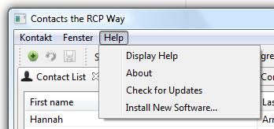
Lab Tasks III: Prepare
Step 6: Export the product
Specify “Generate Metadata repository”
Export and run the exported application
Step 7: Verify that…
The “Check for updates” item is available
The “Install New Software…” item is available
145

Slide 146
Lab Tasks IV: Upgrade your product
Step 1: Configure your application to search for new updates
Open the “Check for Updates” item and add a new update site by opening the “Available Software Sites” preference page
Press “Add…” in order to add your contacts manager update site
Point to the “repository” directory (!!!) of your export directory
Open the “Automatic Updates” preference page and set to check for updates at startup and close the application
Step 2: Change the product
Change the “About” text and the product’s name in the product definition
Change the product version number to 2.0.0
Change the product plug-in’s version number to 2.0.0 in plugin.xml
Change the product plug-in’s version number to 2.0.0 in feature.xml
Change the feature version to 2.0.0 in feature.xml
Remove the feature from the product definition and re-add it (bug in PDE)
Export to the same location
146

Slide 147
Lab tasks
Restart you application in the installation directory
Do you see the update notification?
Update to the new version
Find out how to revert to a previous version
147

Slide 148
Further Information
Eclipsepedia P2: http://wiki.eclipse.org/Equinox_p2
The repository can also be used with the Equinox Installer
See: http://wiki.eclipse.org/Equinox_p2_Installer
Equinox/p2/Adding Self-Update to an RCP Application:
See: http://wiki.eclipse.org/Equinox/p2/Adding_Self-Update_to_an_RCP_Application
148

Slide 149
Agenda
Introduction
Plug-in philosophy
Jobs
Adapters
JFace Wizards
Data Binding
Virtual Trees and Tables
Defining Extension Points
Customizing the Look and Feel
Help System
p2 - Provisioning and Update
Headless build
Wrap-up

Slide 150

Headless Build

Slide 151
Headless Build
Build Plug-ins outside the Eclipse IDE
Requires RCP SDK & the Delta Plug-ins
Build files defined per RCP application
The application should have a Feature Plug-in
Build will be run as an Ant task
Requires a build.xml for the Ant build
An Eclipse build.properties file to feed the build
And, of course, Ant
151

Slide 152
PDE Build
Src Plug-ins
customTargets.xml
Features
Plug-ins
Ant Script Generator
Ant Scripts
Features
Plug-ins
build.properties
Products
Eclipse Platform
Features
P2 Repositories
Plug-ins
Build Config
Input
PDE Build
Output

Slide 153
build.properties
The build.properties file specifies common properties needed for the build:
product: the location of the product configuration file
baseLocation: the location of an Eclipse installation containing all the pre-built Features and Plug-ins that the product requires in features/ and plugins/ subdirectories. The RCP delta pack is mandatory!
buildDirectory: directory the build will take place in
configs: list the configurations for which you want your product to be built
archivePrefix: the name of the directory of your product once installed on disk

Slide 154
customTargets.xml
The custom targets are hooks that are invoked during the build by the main script
Examples are:
clean
prefetch, postfetch
preGenerate, postGenerate
preProcess, postProcess
preAssemble, postAssemble
prePackage, postPackage
test

Slide 155
Enabling p2 (1)
Add the following properties to the build.properties:
p2.gathering=true
p2.metadata.repo=file:${buildDirectory}/repo
p2.artifact.repo=file:${buildDirectory}/repo
p2.flavor=tooling
p2.publish.artifacts=true

Slide 156
Setting up PDE Build for an RCP Product
Create a new simple project called <YOUR_NAMESPACE>.build for the build configuration files
Copy the files build.properties and customTargets.xml from
<ECLIPSE_DIR>/plugins/org.eclipse.pde.build/ <VERSION>/templates/headless-build/
to build/
Edit build/build.properties:
product
archivePrefix
buildDirectory
baseLocation
baseos, basews and basearch

Slide 157
Headless Build Setup
For this course a new simple project should be created to host the build files:
net.eclipsetraining.contacts.build
Prepare a build.properties file
We don’t use custom targets
Prepare a build.xml file
Run the build
Resulting build artifact is a zipped application
157

Slide 158
Prepare the build.properties
The build.properties is based on the same name template file that can be found in the org.eclipse.pde.build Plug-in (in templates/headless-build directory)
The build.properties can be edited using the Eclipse properties editor
###################### Parameters describing how and where to execute the build.
# Typical users need only update the following properties:
# baseLocation - where things you are building against are installed
# bootclasspath - The base jars to compile against (typicaly rt.jar)
# configs - the list of {os, ws, arch} configurations to build.
#
# Of course any of the settings here can be overridden by spec'ing
# them on the command line (e.g., -DbaseLocation=c:/eclipse
#The type of the top level element we are building, generally "feature"topLevelElementType = feature
#The id of the top level element we are buildingtopLevelElementId = org.foo.bar
#
############ PRODUCT/PACKAGING CONTROL ############
#product=/plugin or feature id/path/to/.productrunPackager=true
…
158

Slide 159
Prepare a build.xml file
That build.xml is an Ant build file that is specifically engineered for an Eclipse build:
<project name="net.eclipsetraining.contacts" default="build">
<property file="build.properties" />
<!--
PDE Build expects that the build directory contains a
"plugins" directory and a "features" directory. These
directories should contain the various plug-ins an features
to be built.
This example simply copies the projects directly from your
workspace into the appropriate build directory folders.
-->
…
159

Slide 160
Run the build
First test the correctness of your application by building it inside the Eclipse IDE with the product build tooling (non-headless build)
Run the build.xml with “Run as Ant” (headless build)
…
160

Slide 161
Final build components
The final out-come of the build is a zip packaged RCP application
Best practices:
Use an extra build Plug-in for each application!
Create a Feature for the application!
Separate the Eclipse IDE from the SDK!
Copy the Delta Pack into the SDK!
161

Slide 162
Lab Tasks I: Run headless build from Eclipse
Step 1: Create a new Plug-in for the build project
Name: net.eclipsetraining.contacts.build
Step 2: Create a build properties file
Copy the course build.properties file into your project
Step 3: Create a build file
Copy the course build.xml file into your project
Step 5: Execute the build.xml file as Ant script
Select the build.xml file
Right click and select “Run as Ant”
Step 6: Watch for errors on the console as the build is performed
162

Slide 163
Lab Tasks II: Run headless build standalone
Step 1: Go to the command line and switch to your Plug-in build directory
Step 2: Build the application by executing the build
C:\eclipse\eclipse.exe
–application org.eclipse.ant.core.antRunner
-debug
-verbose
-buildfile ./build.xml
163

Slide 164
Further Information
There are other tools that can help you set up a headless build. For example by utilizing the equinox p2 Plug-in (delivered as part of the Eclipse Ganymede release), google on “Example Headless build for a RCP product with p2” to take a further look at it.
For a more detailed explanation on the inner mechanics of “PDE builds” take a look at the excellent article “Build and Test Automation for Plug-ins and Features” written by Markus Barchfeld.
164

Slide 165
Agenda
Introduction
Plug-in philosophy
Jobs
Adapters
JFace Wizards
Data Binding
Virtual Trees and Tables
Defining Extension Points
Customizing the Look and Feel
Help System
p2 - Provisioning and Update
Headless build
Wrap-up

Slide 166
Wrap-up
Summary
Did you reach your goals?
Q & A
...
Thank you!

Slide 167
License
THIS WORK IS PROVIDED UNDER THE TERMS OF THE CREATIVE COMMONS Attribution-NonCommercial-NoDerivs 2.0 GERMANY PUBLIC LICENSE (http://creativecommons.org/licenses/by-nc-nd/2.0/de/deed.en_US) AND PROTECTED BY COPYRIGHT AND/OR OTHER APPLICABLE LAW. ANY USE OF THE WORK OTHER THAN AS AUTHORIZED UNDER THIS LICENSE OR COPYRIGHT LAW IS PROHIBITED.

